Slide 1



Slide 2
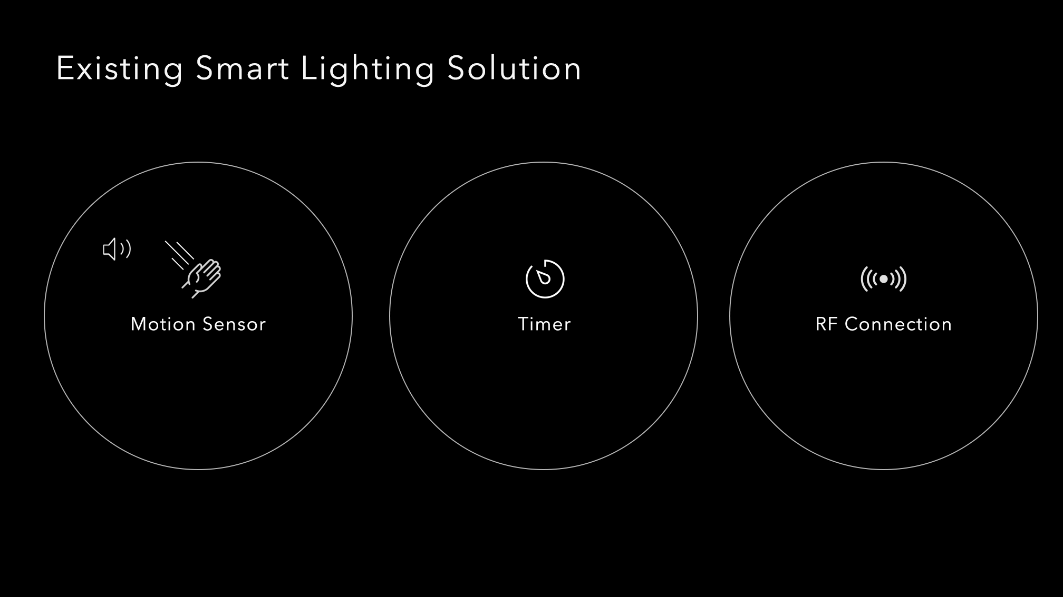

Slide 3
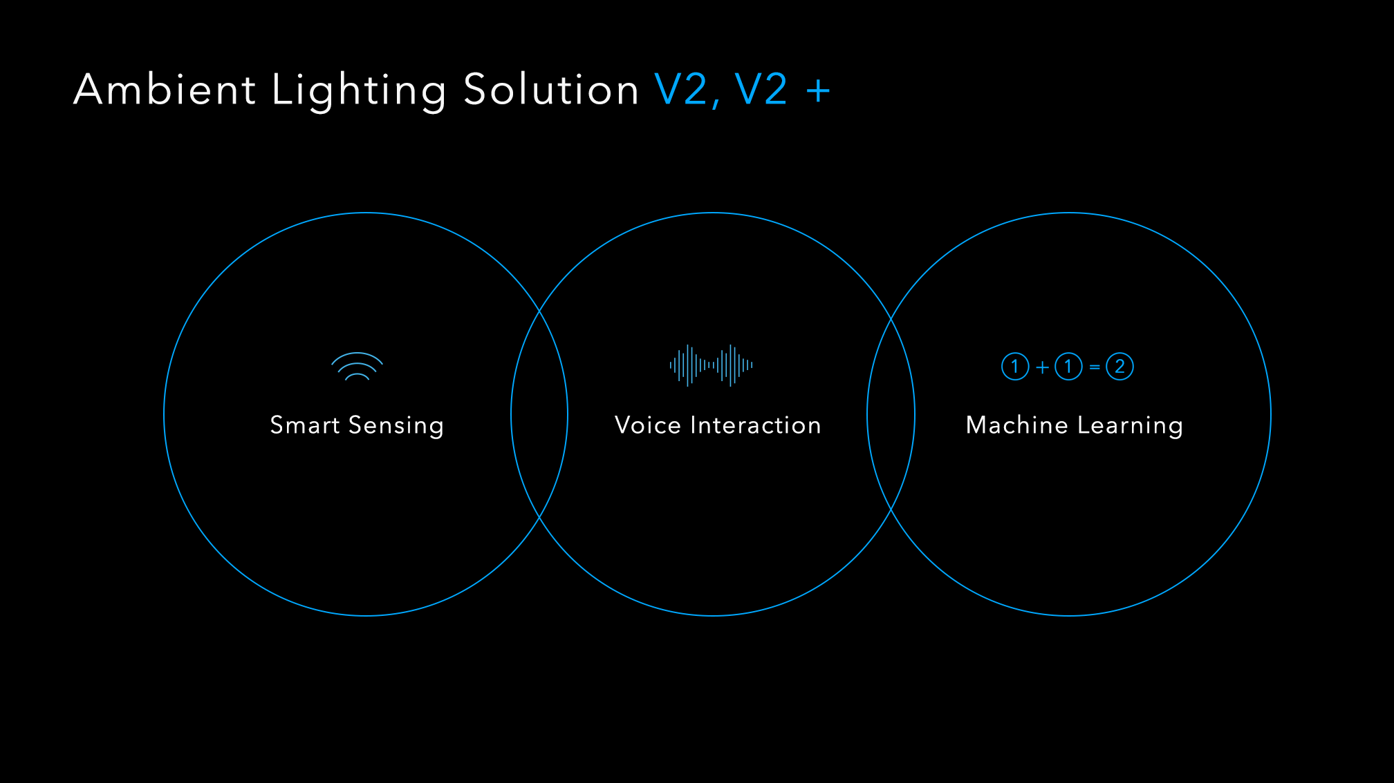

Slide 4
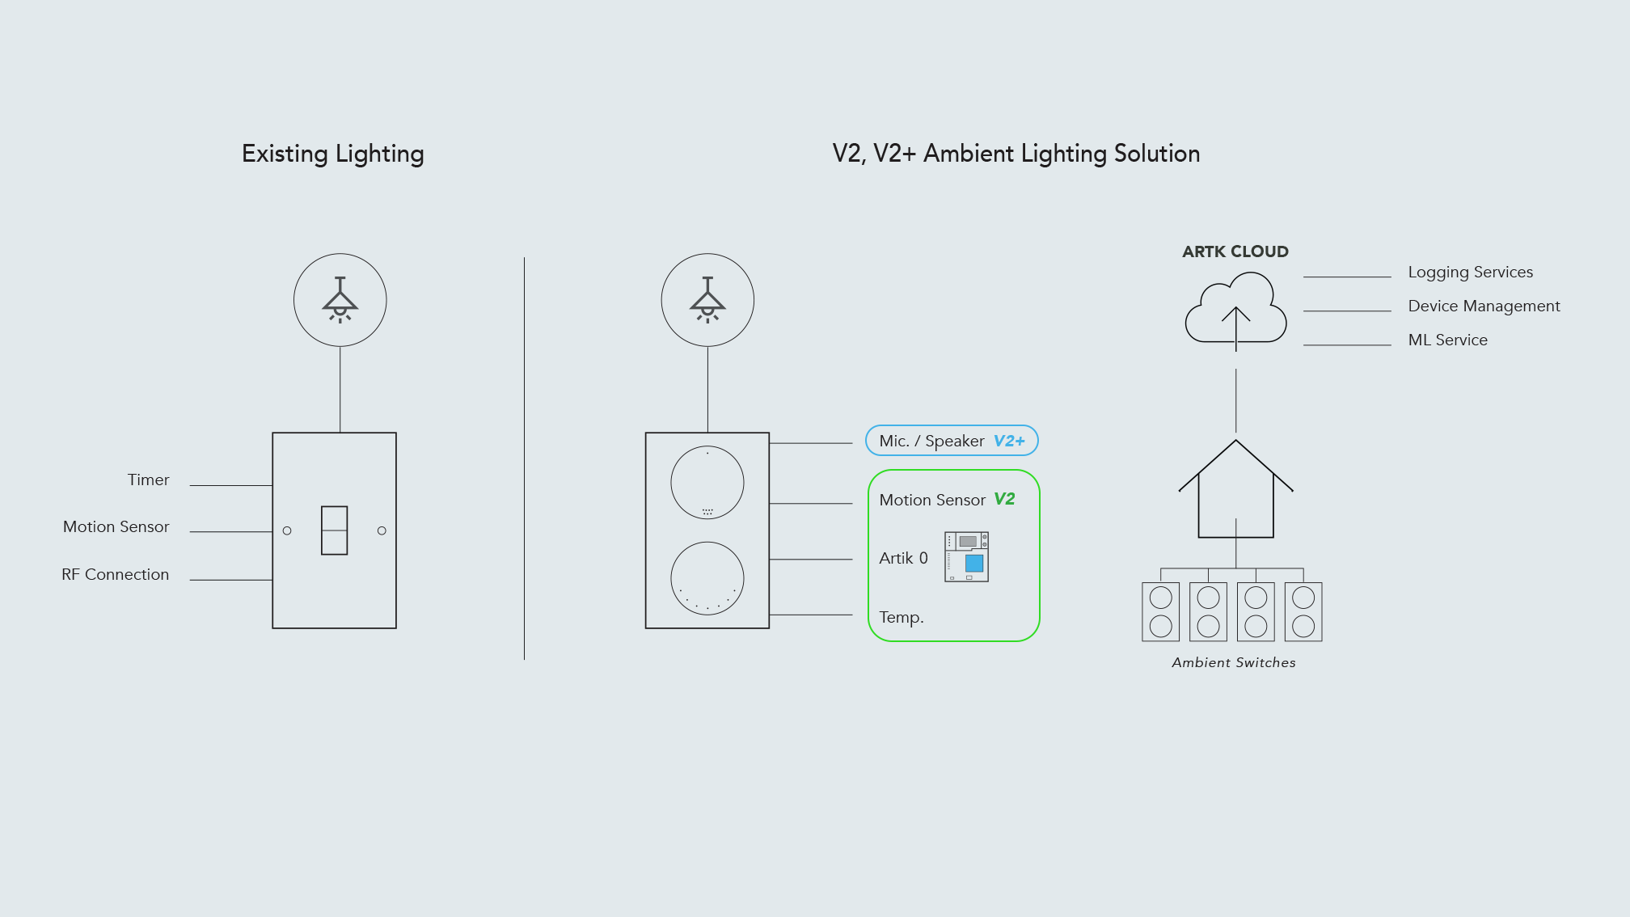

Slide 5
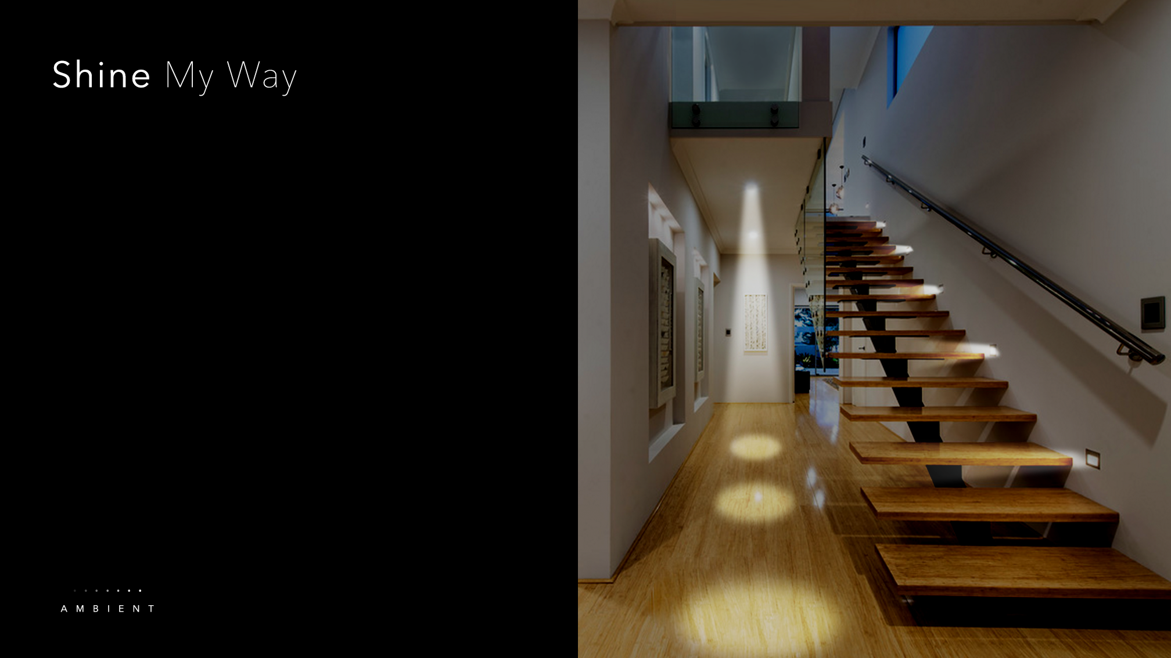
Corners of house illuminates as user move through space
Brightness level / room temperature adapts to occupancy

Slide 6
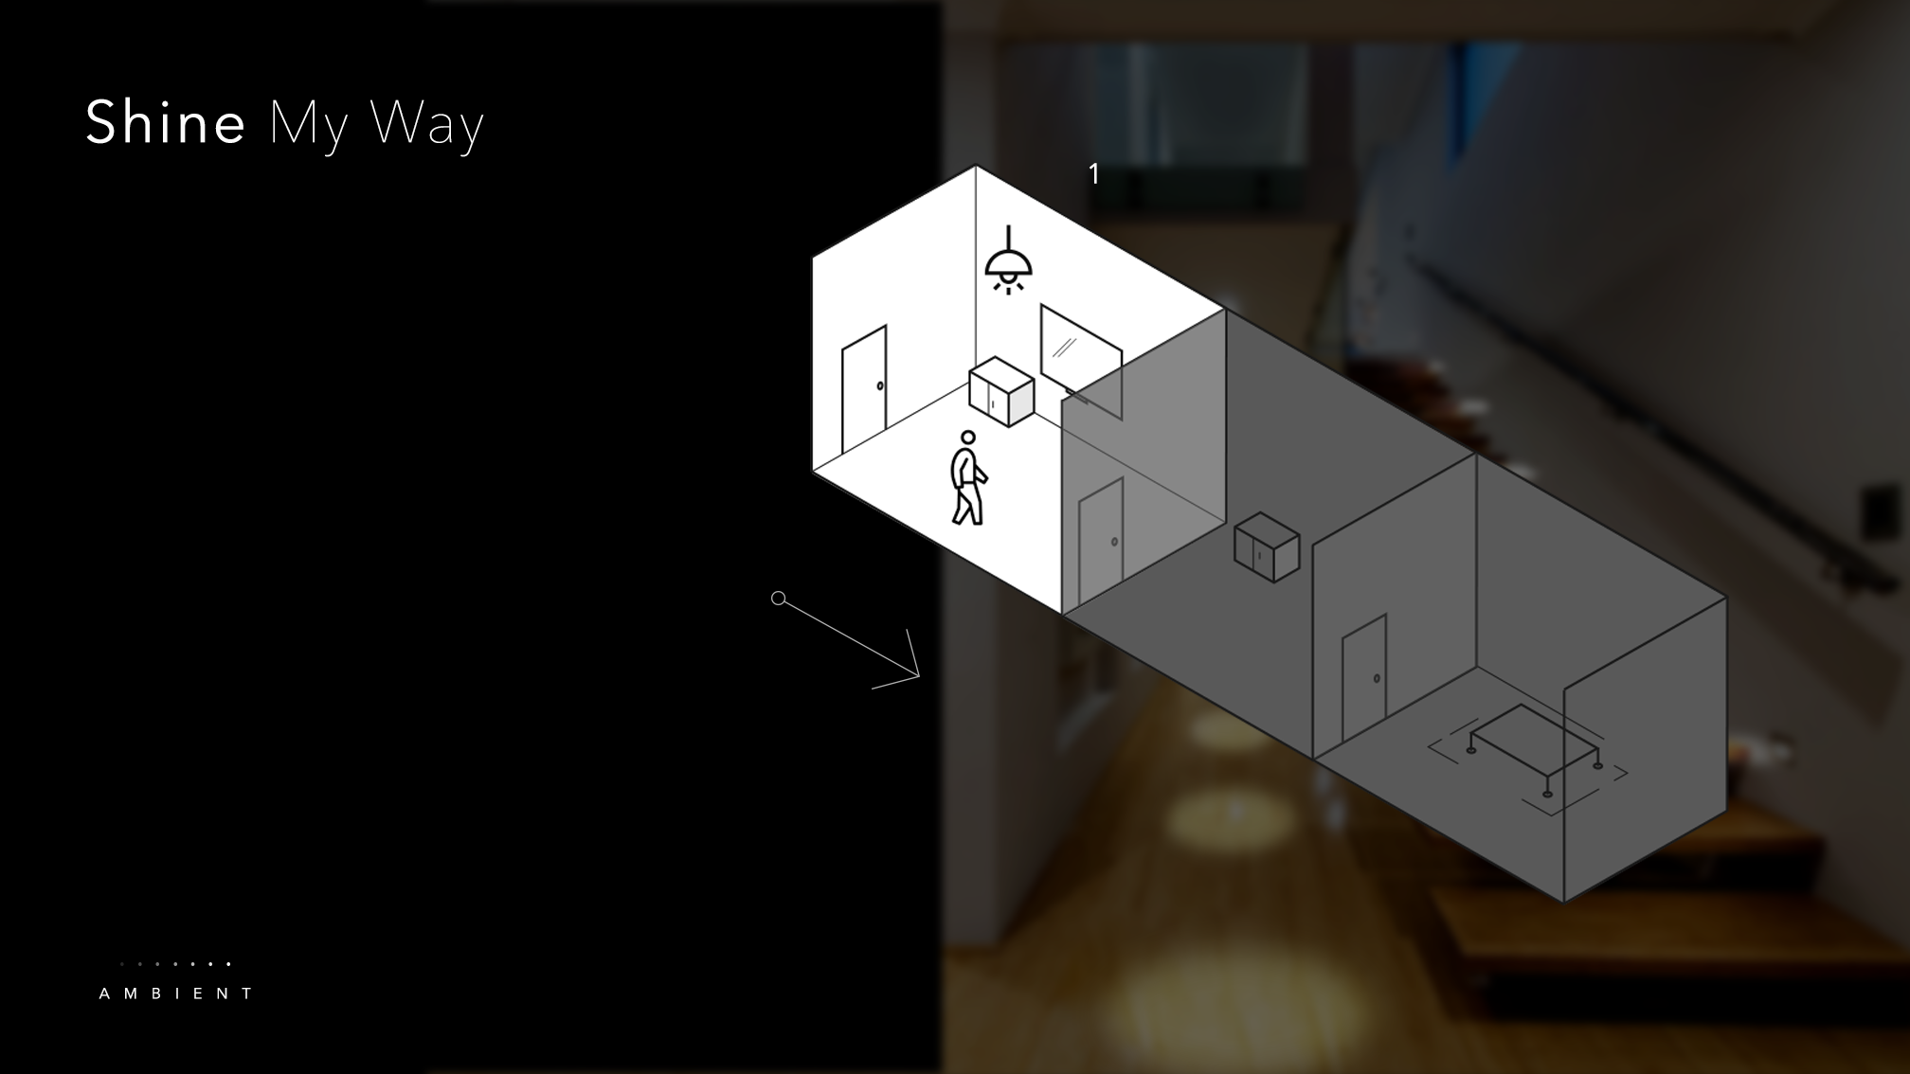
Corners of house illuminates as user move through space
Brightness level / room temperature adapts to occupancy

Slide 7
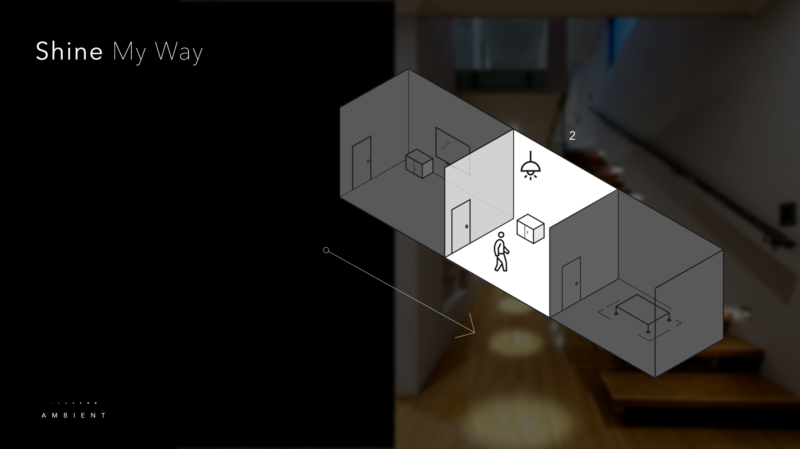
Corners of house illuminates as user move through space
Brightness level / room temperature adapts to occupancy

Slide 8
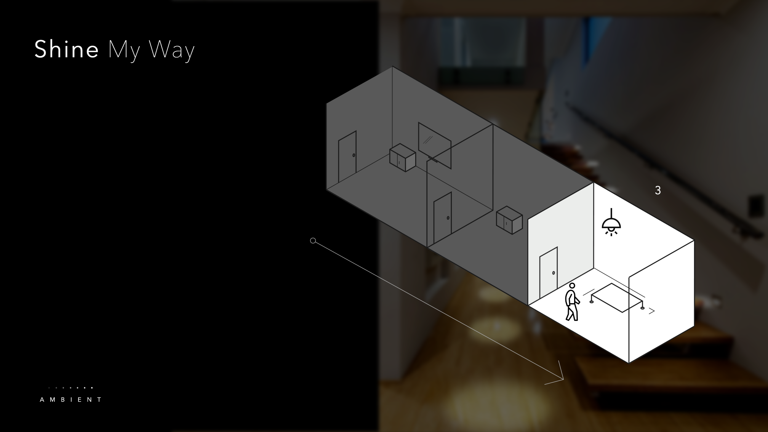
Corners of house illuminate as user move through space
Brightness level / room temperature adapts to occupancy

Slide 9
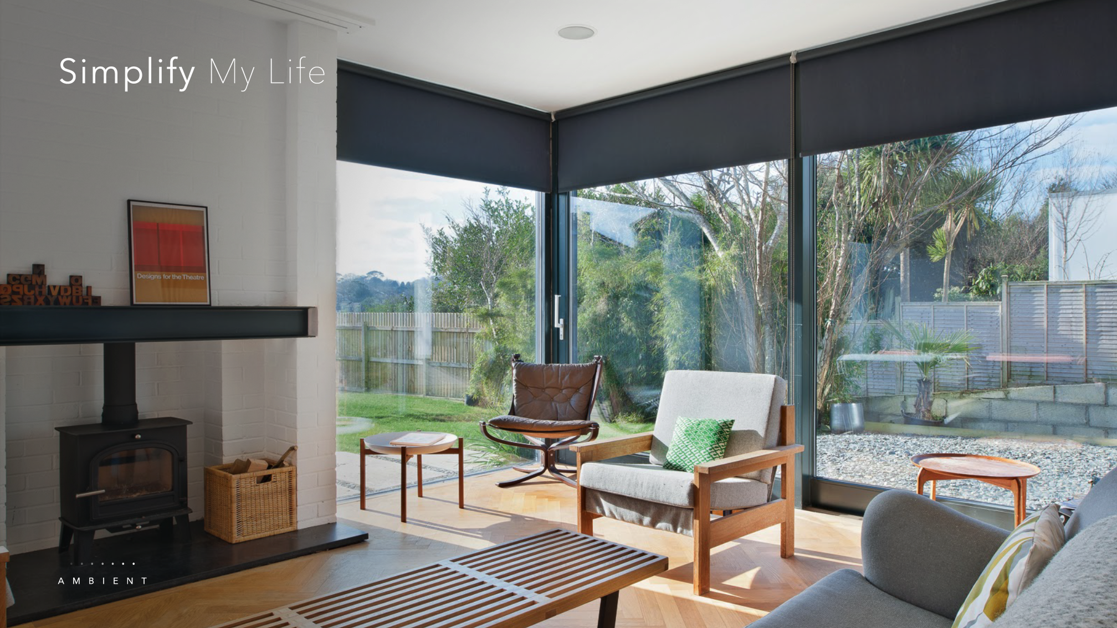
Coordinate all light sources to provide optimal setting for the right context with one single control
Real-time data based automation taking into account of season, weather, and time of day

Slide 10
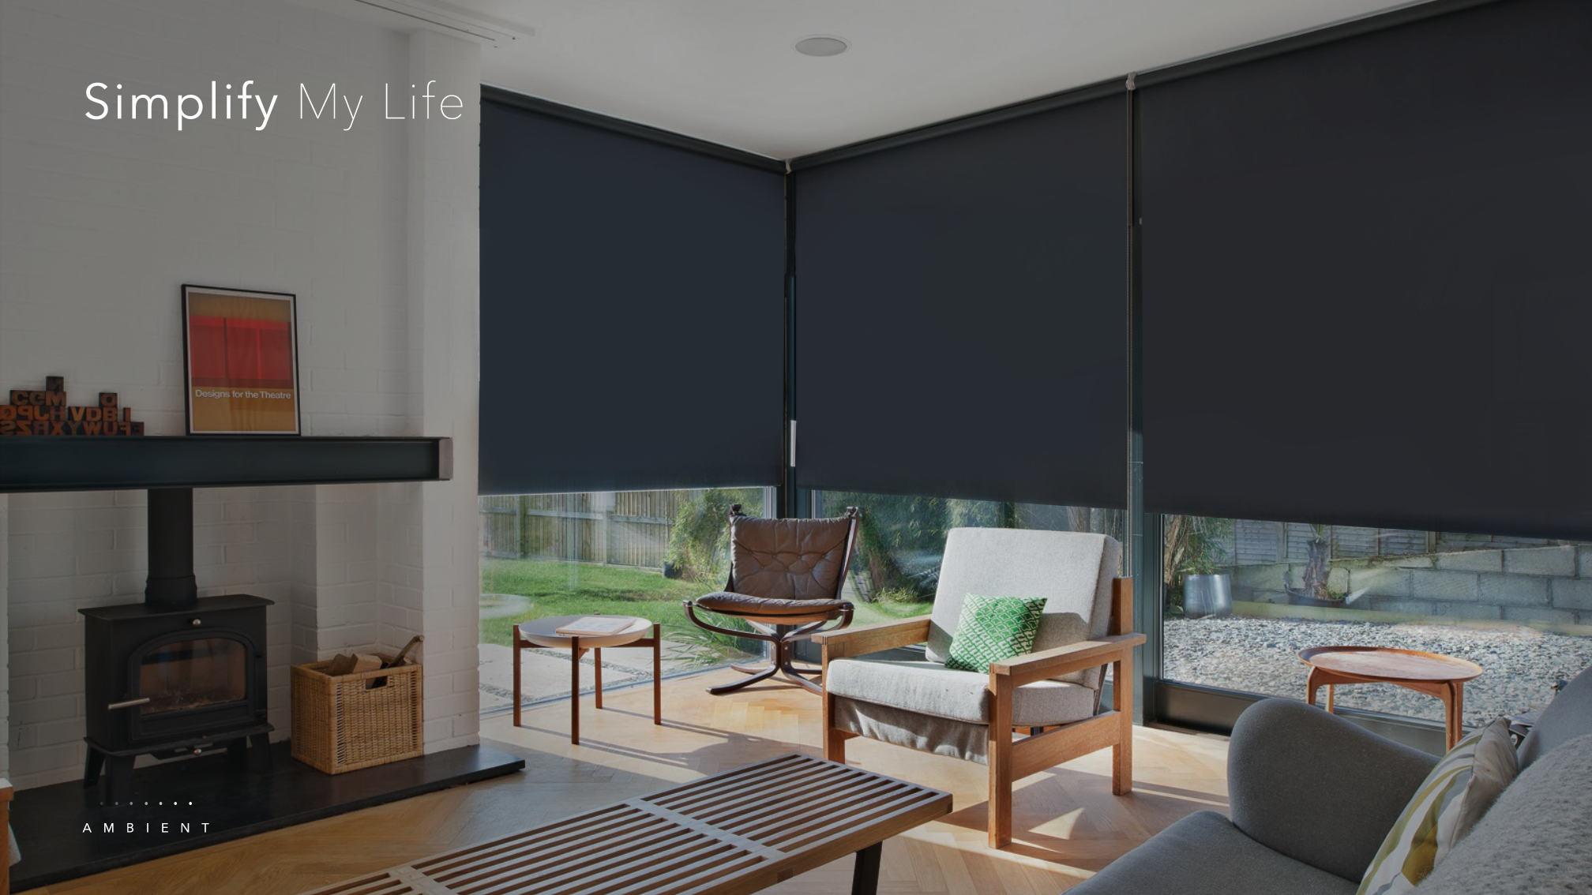
Coordinate all light sources to provide optimal setting for the right context with one single control
Real-time data based automation taking into account of season, weather, and time of day

Slide 11
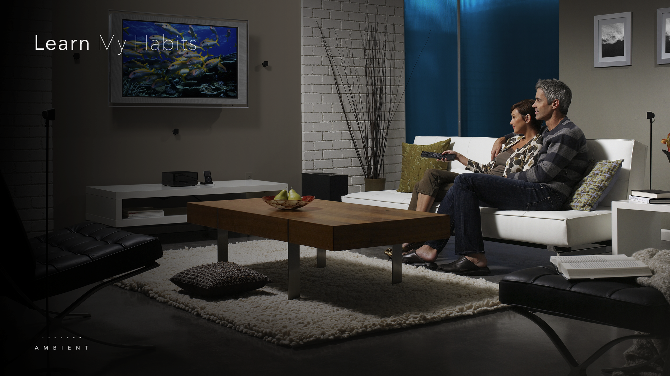
Learns user habits from previous usage pattern by using machine learning algorithms
Anticipates user needs and controls lighting without complex programming setup

Slide 12
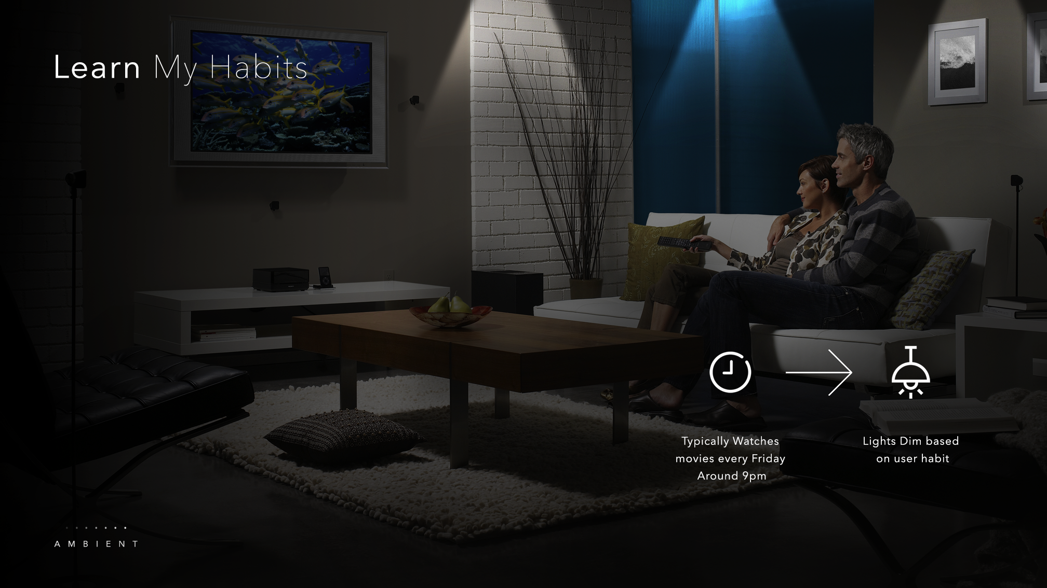
Learns user habits from previous usage pattern by using machine learning algorithms
Anticipates user needs and controls lighting without complex programming setup

Slide 13
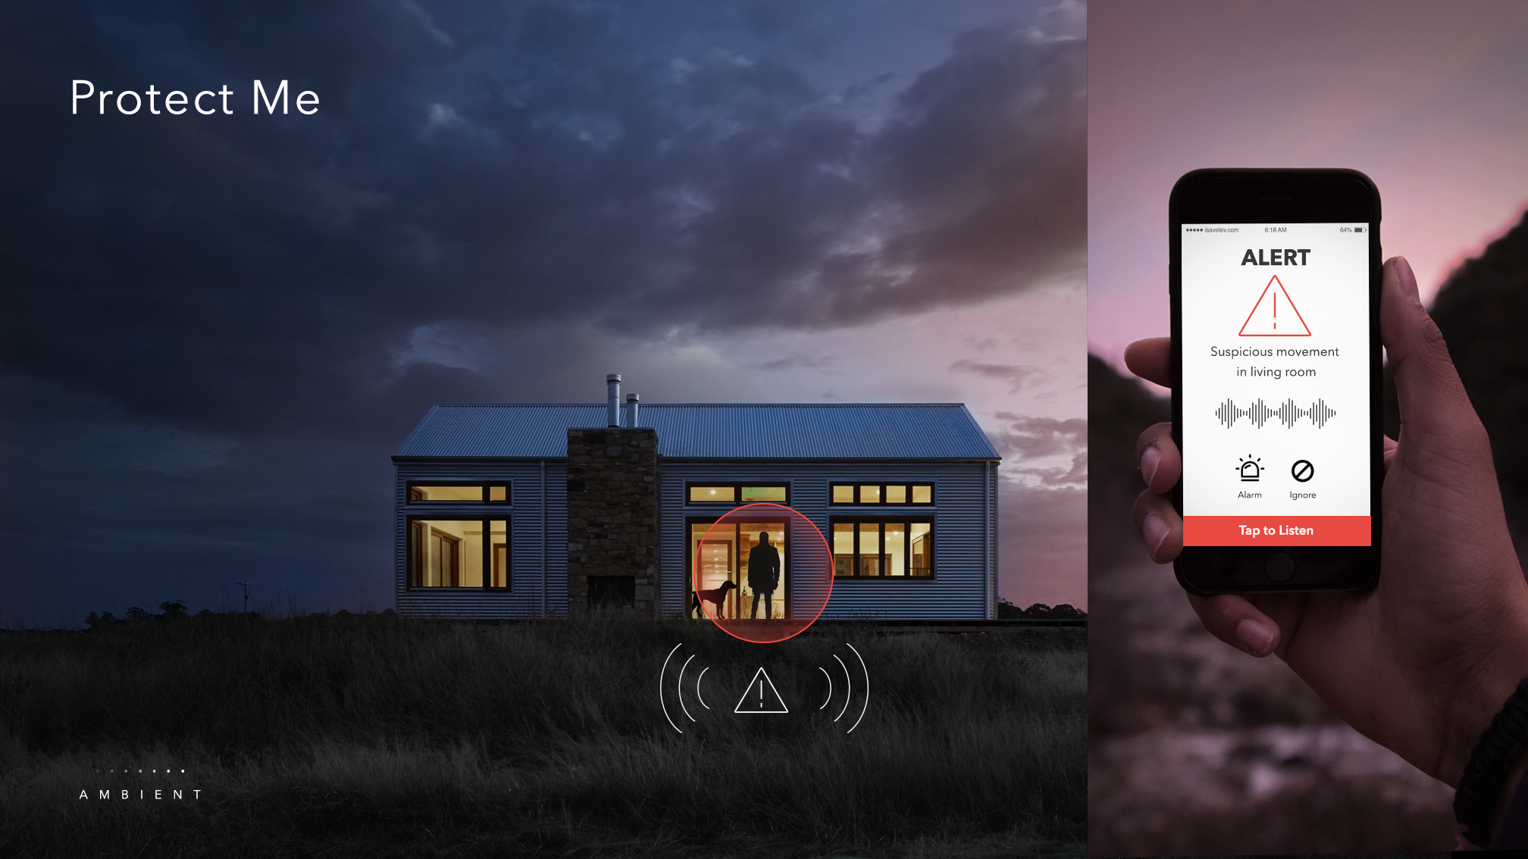
Suspicious movement/ noise is monitored across rooms
Irregular motion triggers notification on home owner’s phones
Voice warning follows movement of unwelcome intruders

Slide 14
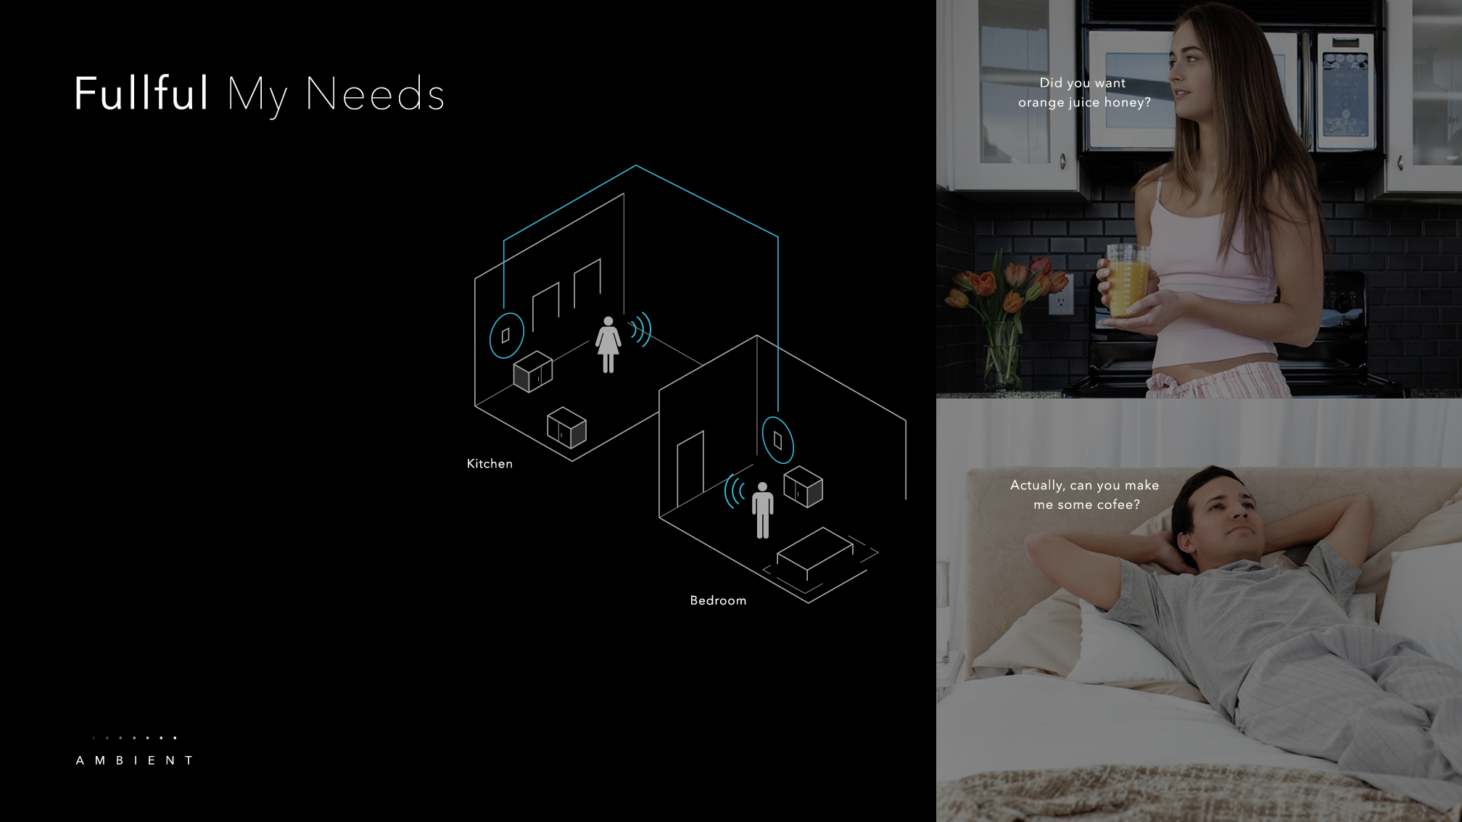
Controls connected devices via conversational voice interaction
Uninterrupted media playing/ call experience from room to room
Whole house intelligent assistant
( traffic, sports, news, and weather)

Slide 15
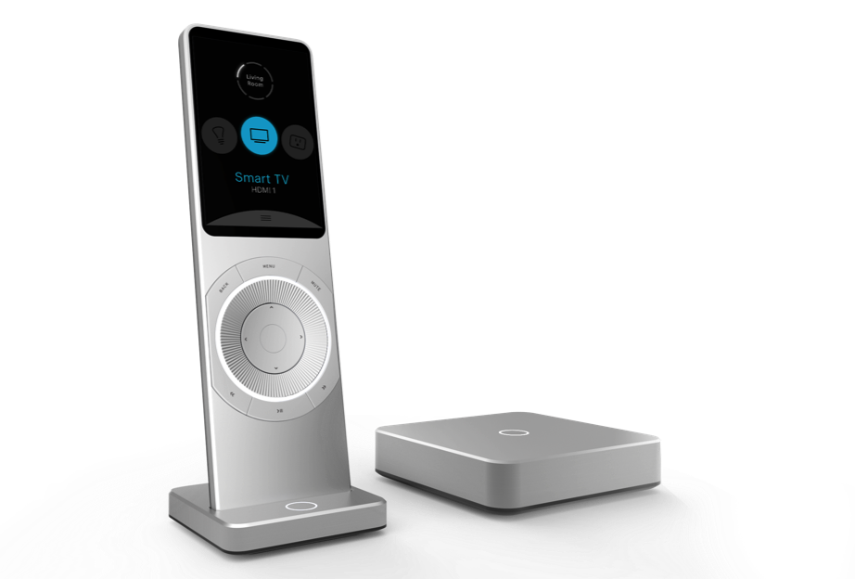
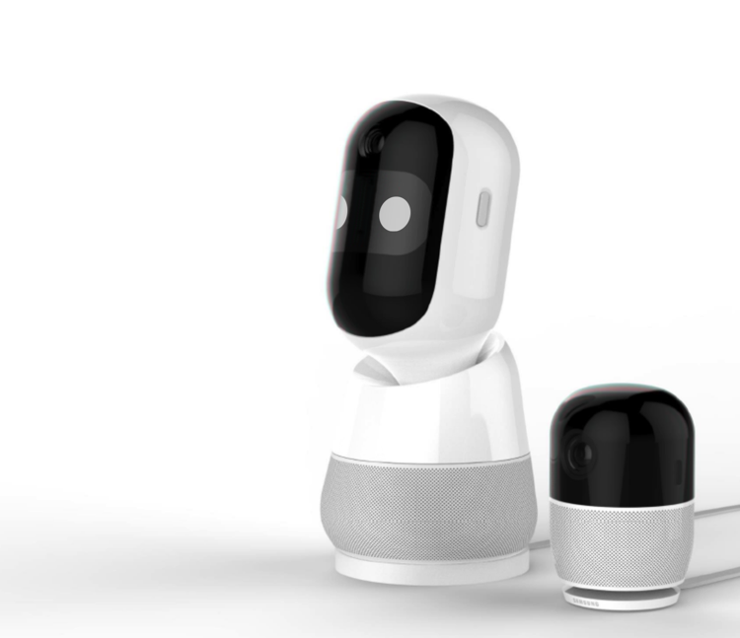


Reference Products
The Everything Remote for Smart Home
Your Friend in the Home
Notes:
The Everything Remote for Smart Home

Slide 16
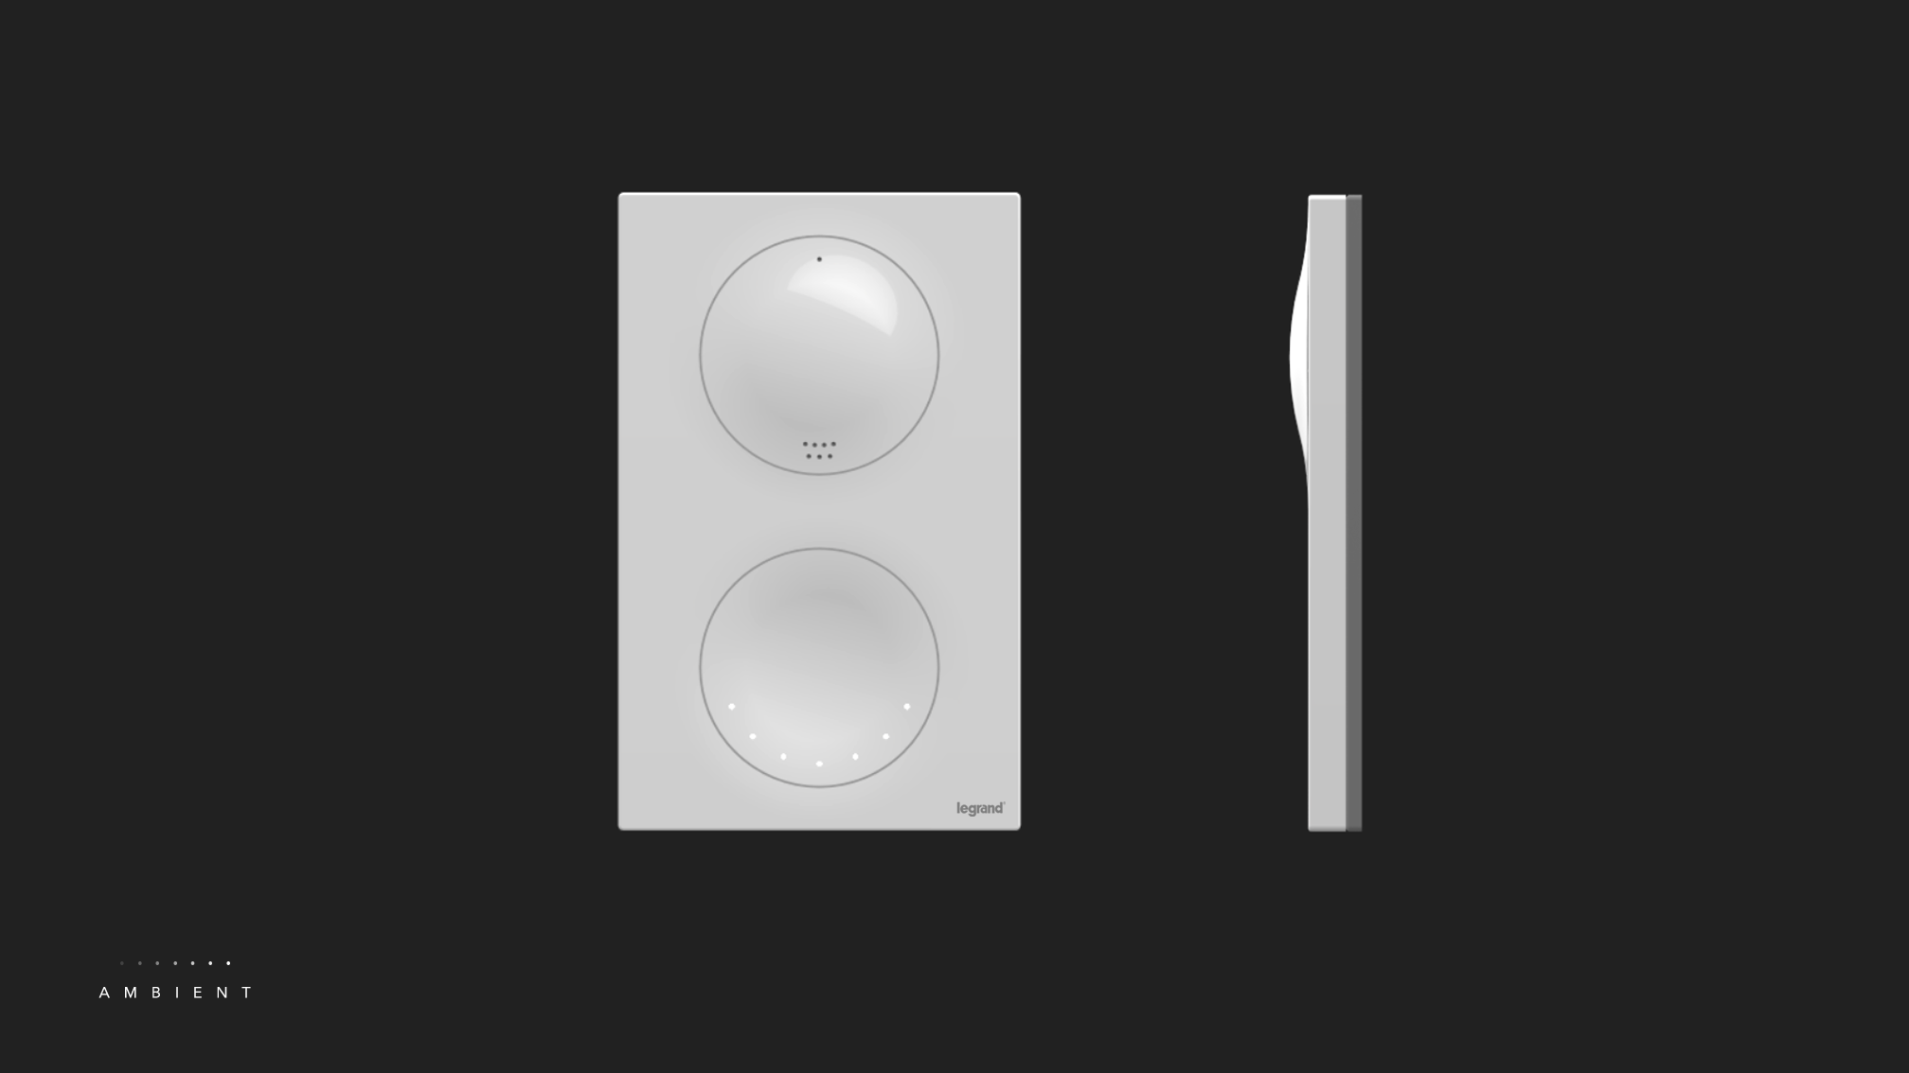

Slide 17
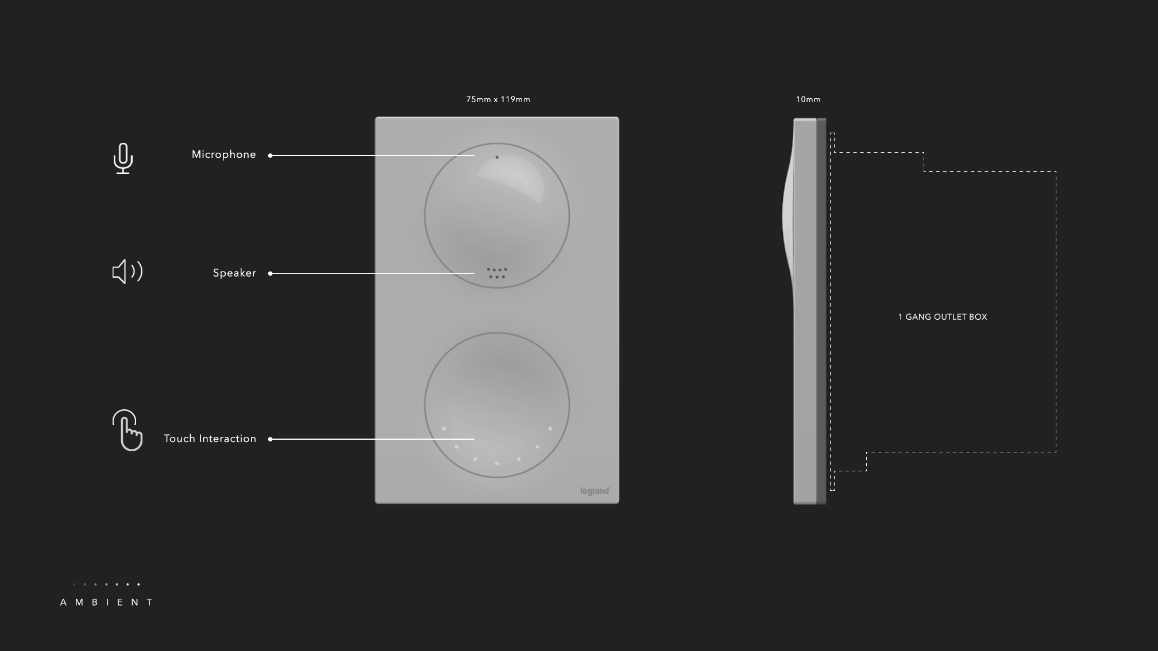

Slide 18
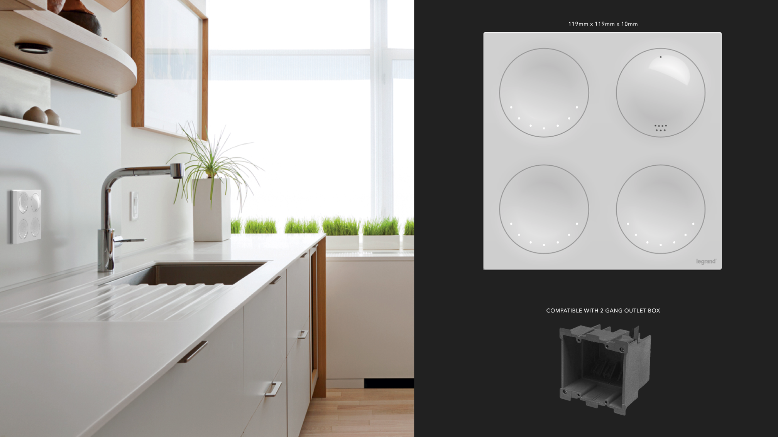

Slide 19


